Slide 1
IBM Capstone
James Briggs

Slide 2
Forest Cover Type Dataset
Tree observations from four areas of Roosevelt National Forest in Colorado
Consists of cartographic observations:
tree type
shadow coverage
elevation
soil type
etc

Slide 3
Objective
Use simple cartographic measurements to predict tree type, benefits in increased geographic information systems (GIS) automation
Environmental impact analysis
Determination of land cover/use
Management of natural resources
Features (inputs) are continuous and one-hot encodings
Targets (output/predictions) are discrete (tree type categories 1-7)

Slide 4
Data Exploration
Data Integrity and Characteristics
Datatypes
Null samples/data points
Feature Distribution
Anomalous data points

Slide 5
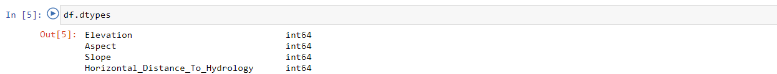
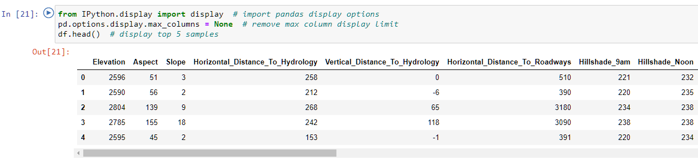
Datatypes
Quick look at dataframe head with all columns

Slide 6
Nulls

Slide 7
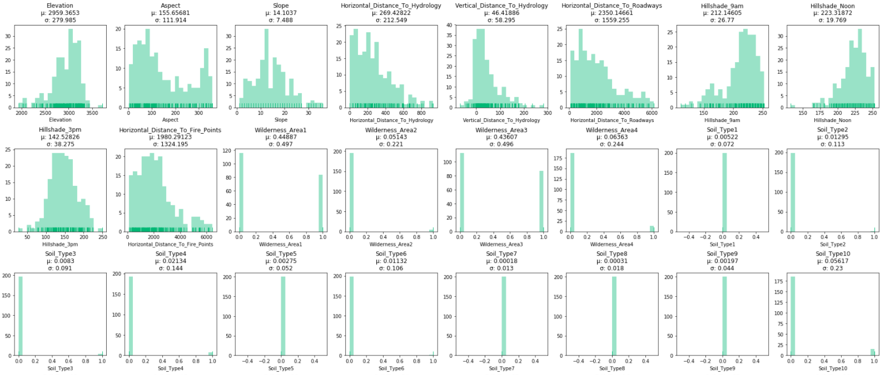
Feature Distribution
Notes:
First several features are continuous, pretty typical distributions
Then we see Wilderness area is either 0 or 1, so it is clearly a categorical/Boolean value
Soil_Type is the same

Slide 8
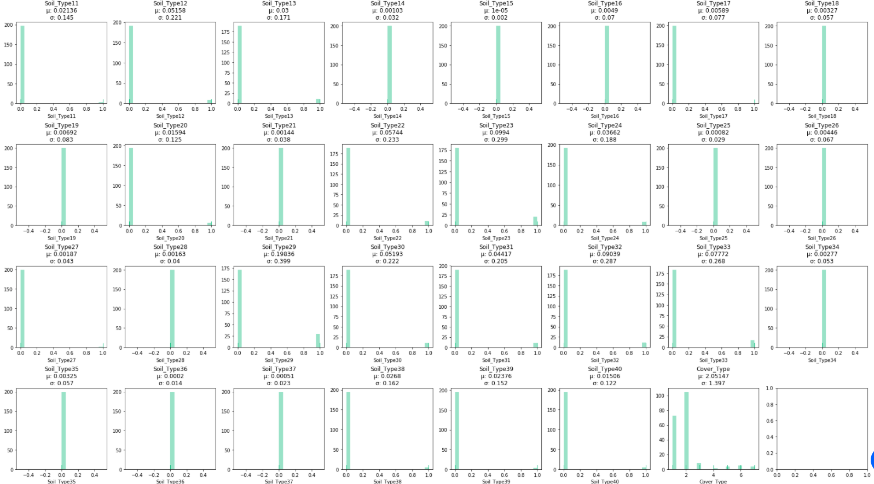
Notes:
So we can see all Soil_Type features are categorical, I checked the sum of all ‘Soil_Type’ data points for each sample, and they it always equalled 1, so they’re just one-hot encoded category columns
Also we can see cover type is also a discrete/categorical column, where the cover type/tree type is either 1, 2, 3, 4, 5, 6 or 7
- this is our target, so the end product will be a multiclass classifier

Slide 9
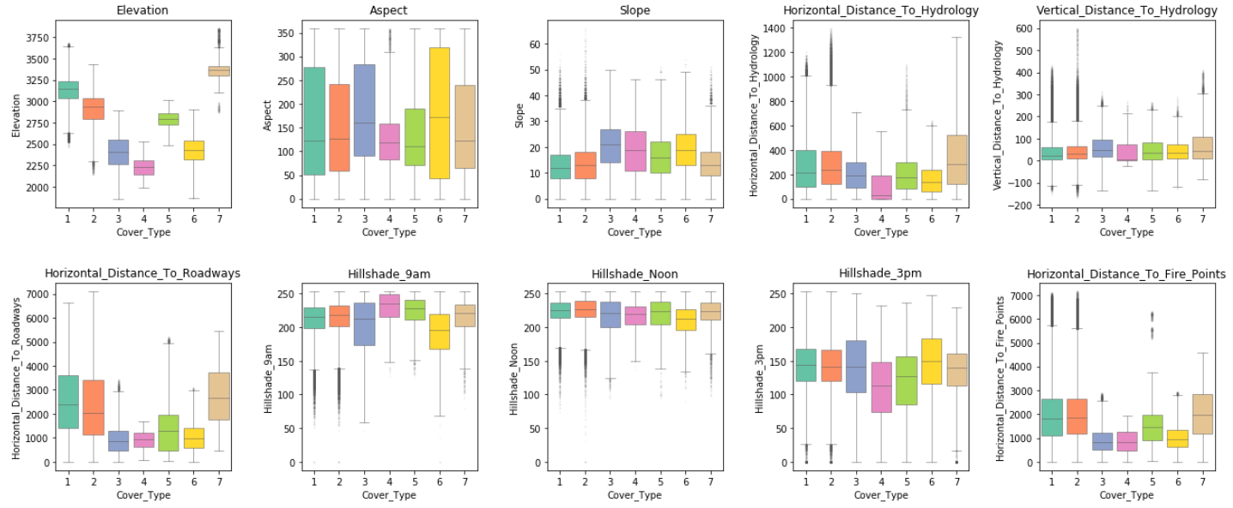
Anomalous Data Points
Notes:
We can see there’s a reasonable amount of data being classified as outliers
We are using the seaborn boxplot default for outliers which is anything further than 2.0 of the interquartile range (which is high, but the typical 1.5 was far too low for this dataset)
We have a lot of data (581012) so it makes sense
Looking at cover_type 1 and 2 for vertical distance to hydrology, there’s either weird data, or some of those types of trees just grow a lot higher from the hydrology than would be expected
Looking at the same types (1 and 2) in the elevation boxplot, you can see both types have very large ranges, so to me it kind of makes sense…
same for horizontal distance, if these trees can grow over a greater vertical range, it would make sense that they would grow in areas with a further horizontal range too,
this is reflected in the Horizontal Distance to Roadways graph to
For hillshade outliers, we can see for types 1 and 2 that the outliers are on opposite sides, so I think this makes sense as the sun moves from one side to the other in that time, so the outliers would also be on opposite
The only bit which is kind of weird is the horizontal distance to fire points for cover type 5, but then this type does also have a large horizontal distance to roadways range, so it sort of makes sense too, just weird that
they’re so far seperated from the main body of samples
So generally I’m not particularly worried about these outliers, I’m keeping them in the dataset as I don’t want to prune it too much so that it, hopefully fits better to unseen data

Slide 10
Feature Engineering
Look for features that are irrelevant/can be merged
Correlation matrix + split one-hot target
Normalisation of continuous input features
One-hot encoding of target feature Cover_Type
Notes:
Continuous input features = elevation, vertical distance to hydrology

Slide 11
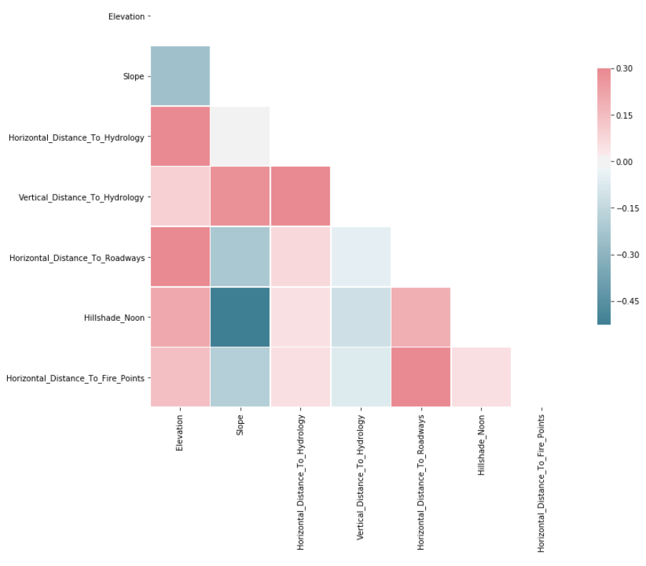
Correlation Matrix
Notes:
We can see higher +ve/-ve correlation between
elevation/horizontal distance to hydrology
Elevation/horizontal distance to roadways (higher up it is = less roads)
slope/hillshade_noon
Slope/vertical distance to hydrology (higher = steeper/cliffsides)
Horizontal/vertical distance to hydrology (IF hydrology = rivers, rivers obey gravity so higher terrain will also have less running water)
Horizontal distance to roadways/to fire points, (more isolated, less man-made stuff)

Slide 12
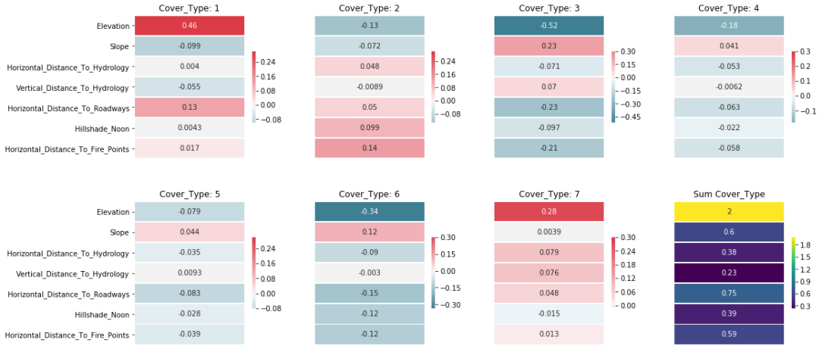
Continuous Feature Correlation with Cover_Type
Notes:
Anything with a correlation between 0.1 throughout is either removed or merged (not including the SUM part)
- This meaning ‘Vertical Distance to Hydrology’ and ‘Horizontal Distance to Hydrology’

Slide 13
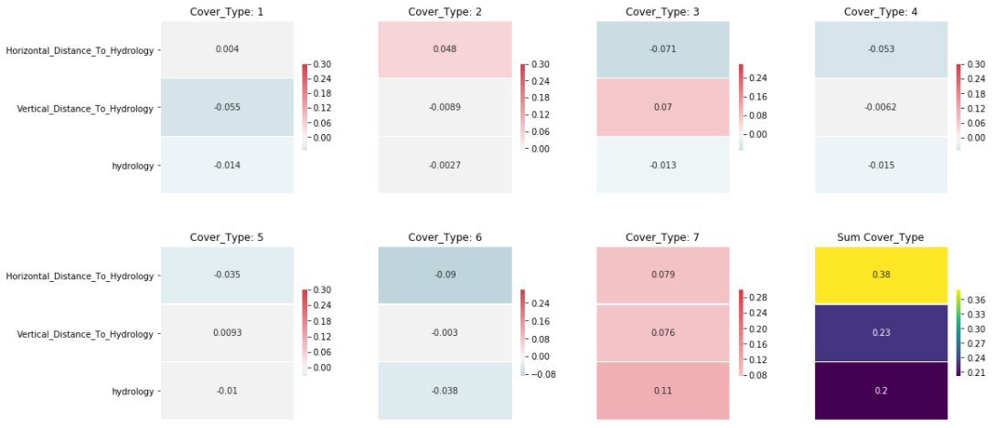
Hydrology Feature Merge

Slide 14
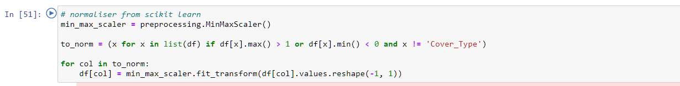
Normalisation

Slide 15
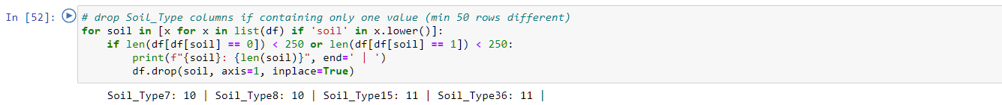
Removing Soil_Type Columns with Little Variation

Slide 16
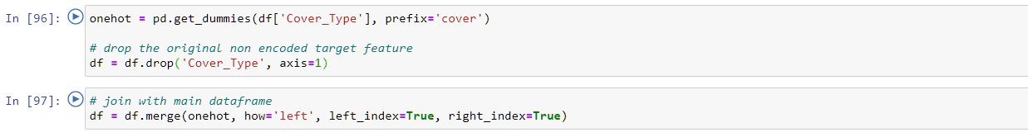

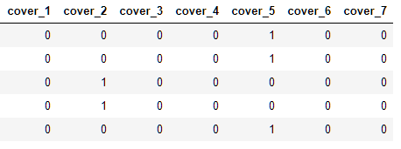
One-Hot Encoding

Slide 17
Model Definition
Performance metrics:
Accuracy (%)
MSE
Models
Logistic Regression
Dense Neural Network
Feature Engineering Impact

Slide 18
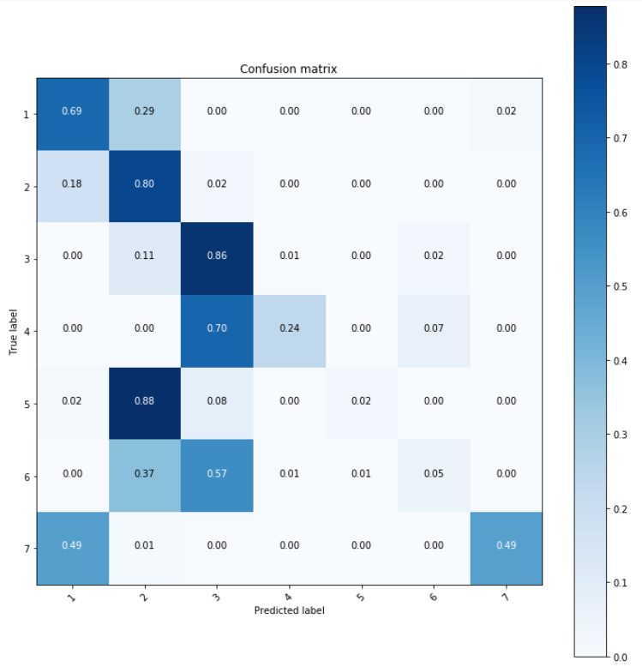
Logistic Regression
Seven total logistic regression models
Each gives a probability, the argmax of all probabilities is our prediction
Does not deal well with less common Cover_Type classes
Accuracy: 71%

Slide 19
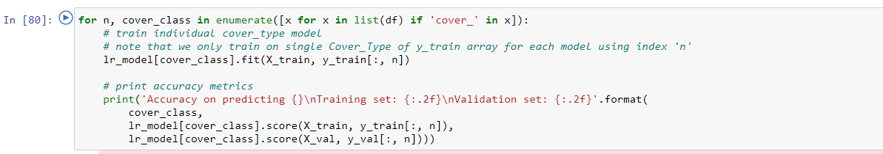
Code

Slide 20
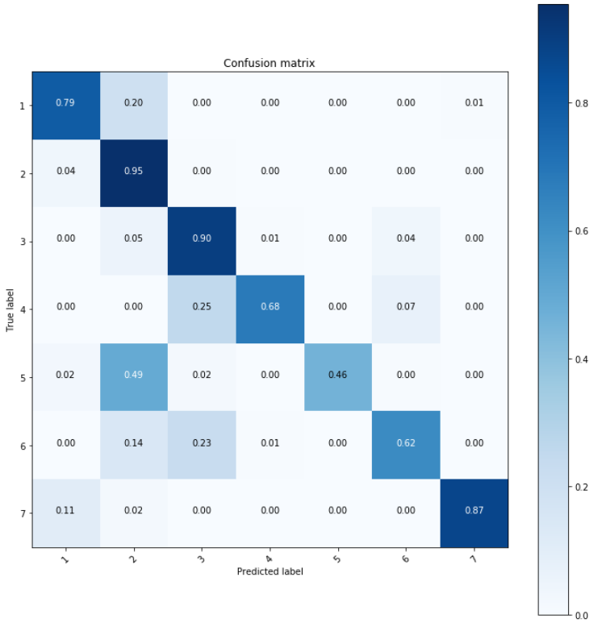
Densely Connected Neural Network
Wide three-layer deep NN layers
ReLU activation functions
Softmax activation for multi-label output layer

Slide 21
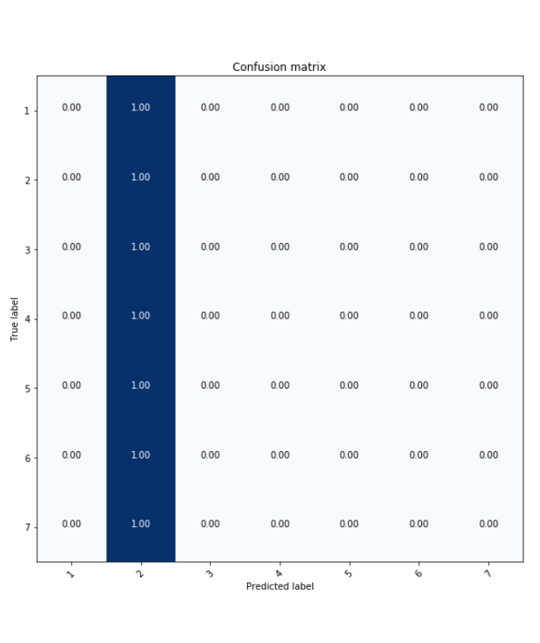
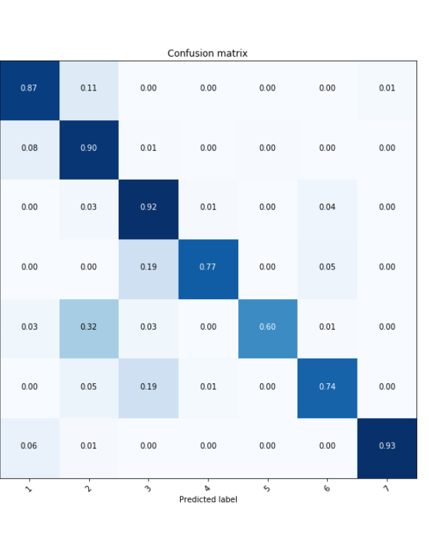
Feature Engineering Impact
With feature engineering:
Train | Val accuracy: 87.43% | 87.19%
Train | Val MSE: 0.3122 | 0.3174
Test set accuracy: 87%
Without feature engineering:
Cannot make predictions, defaults to Cover_Type2 for all samples.
Normalised (without other feature engineering) reached comparable performance to model.

